Slide 1
Day 2: Characterization of the local field potential and its relation to spiking activity
Junji Ito | Institute of Neuroscience and Medicine (INM-6) and Institute for Advanced Simulation (IAS-6), Jülich Research Centre and JARA, Jülich, Germany
SPP 1665 Analytical Workshop: Analysis and Management of Electrophysiological Activity Data
Forschungszentrum Jülich, Jülich, Germany (Nov. 24-27, 2014)

Slide 2
Outline
Introduction
What is LFP? | LFP origin | oscillations in LFP
Spectral Analysis
Fourier transform | power spectrum | coherency
Phase Locking Analysis
Hilbert transform | wavelet transform | phase locking value
Spike-LFP Relation
spike triggered average | spike field coherence | period histogram | vector strength

Slide 3
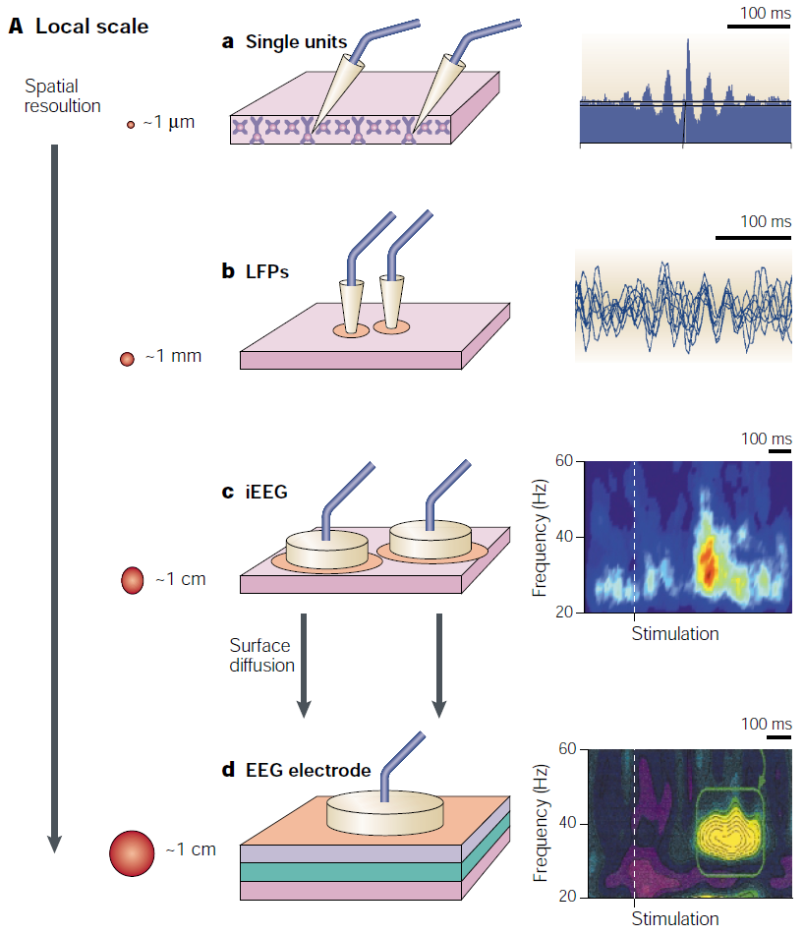
Introduction | what is local field potential?
Local field potential (LFP) is…
electric potential → high temporal resolution
measured within the brain using microelectrodes → high spatial resolution
caused (primarily) by excitatory synaptic currents of nearby neurons → reflection of inputs to the local neuronal circuit
Varela et al. (2001) Nat. Rev. Neurosci. 2:229–39

Slide 4
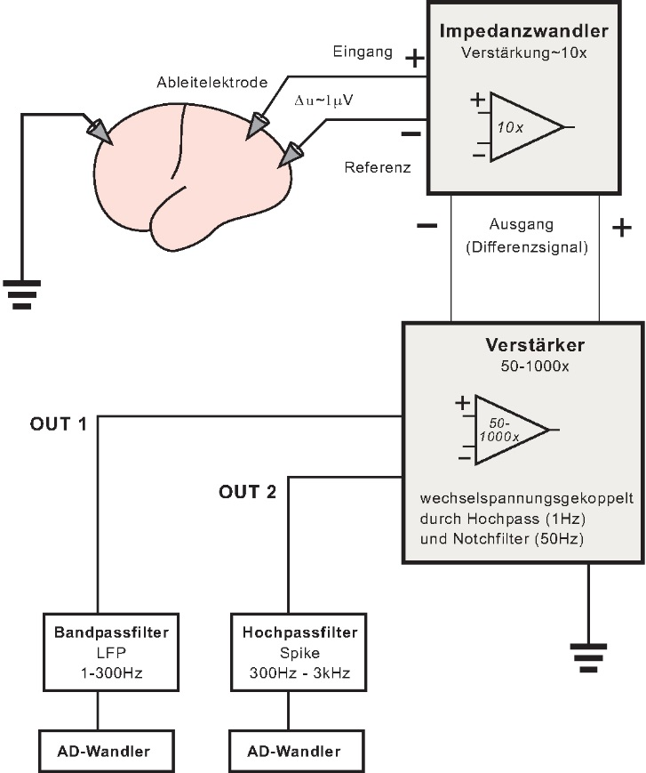
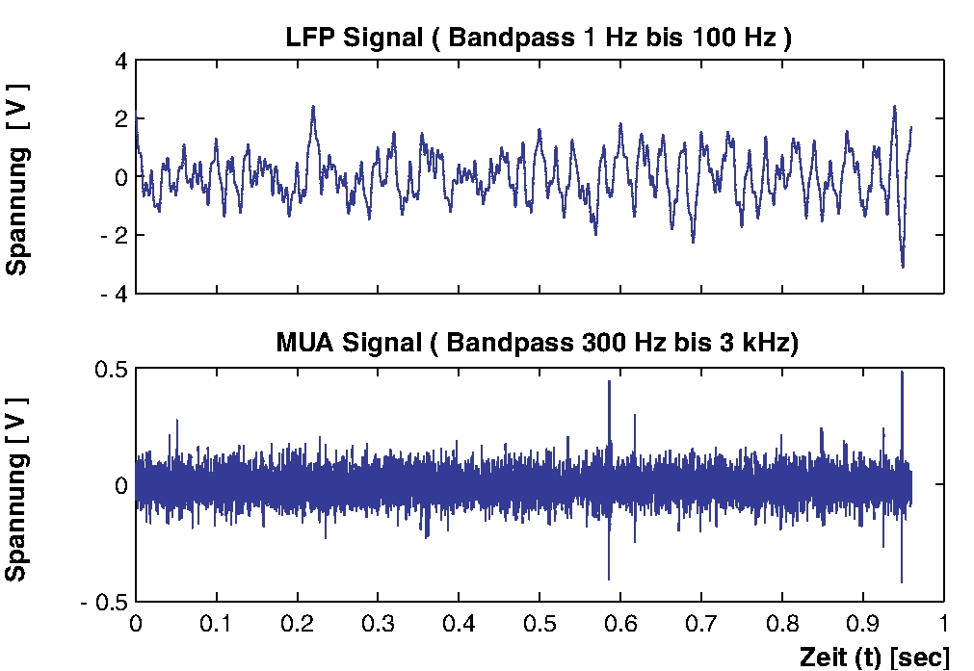
Introduction | how to obtain the LFP?
LFP is the low-pass filtered voltage signal

Slide 5
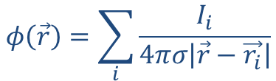
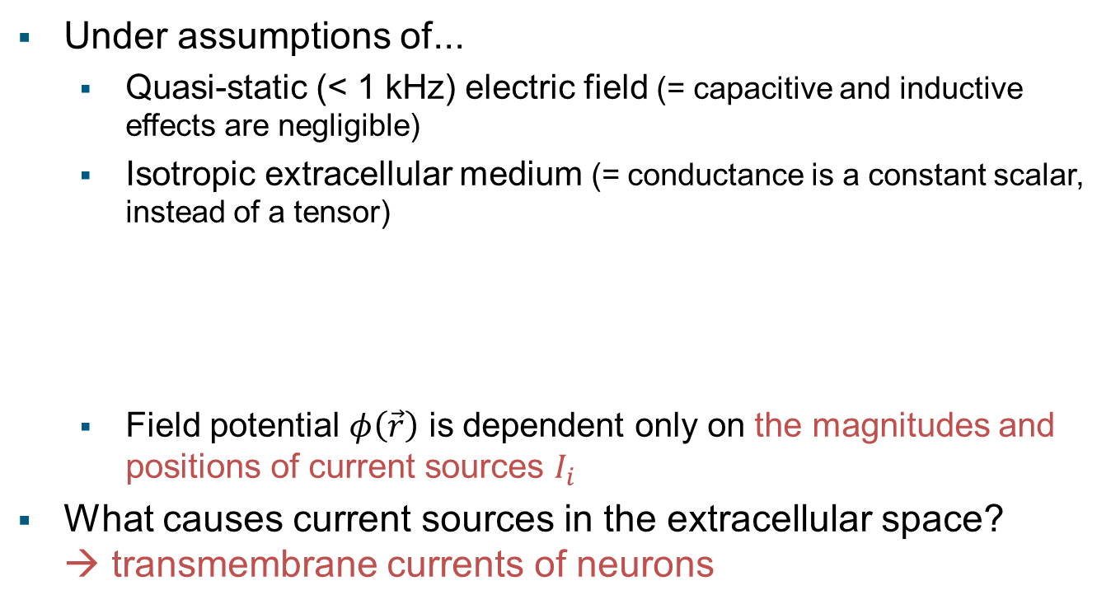
Introduction | what is the origin of the LFP?
Under assumptions of...
Quasi-static (< 1 kHz) electric field (= capacitive and inductive effects are negligible)
Isotropic extracellular medium (= conductance is a constant scalar, instead of a tensor)
Field potential $φ\left(\vec{r}\right)$ is dependent only on the magnitudes and positions of current sources $I_{i}$
What causes current sources in the extracellular space? → transmembrane currents of neurons
$$φ\left(\vec{r}\right)=\sum_{i}{\frac{I_{i}}{4πσ\left|\vec{r}−\vec{r_{i}}\right|}}$$
$φ(\vec{r})$: field potential at $\vec{r}$ $I_{i}$: current source at $\vec{r_{i}}$ $σ$: conductance of extracellular medium

Slide 6
Introduction | cause of transmembrane current
Action potentials (APs)
Biphasic in time, easily cancelled out by temporal jitter of multiple APs
Excitatory and inhibitory post-synaptic potentials (EPSP, IPSP)
Ratio of EPSP- vs. IPSP-related current components = 5:1 (Mitzdorf, 1985)
EPSP is the dominant cause of the macroscopic transmembrane current (and therefore the LFPs) in the brain.
Mitzdorf (1985) Physiol. Rev. 65:37-100

Slide 7
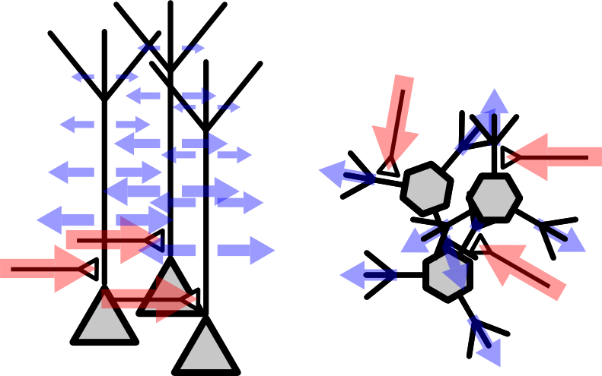
Introduction | cell morphology and LFP
A cell is always electrically neutral → current sink is cell-wise counter-balanced by current source
Spatial distribution of sinks and sources depends on cell shapes
Overlapping current sinks and sources cancel each other
Only localized current sinks and sources contribute to macroscopic LFP
Excitatory synaptic inputs to pyramidal neurons contribute most to the cortical LFP

Slide 8
Introduction | an example LFP recording
Laminar LFP recording from the area IT of an anesthetized macaque (data by courtesy of Prof. Tamura, Osaka Univ.)
LFP movie

Slide 9
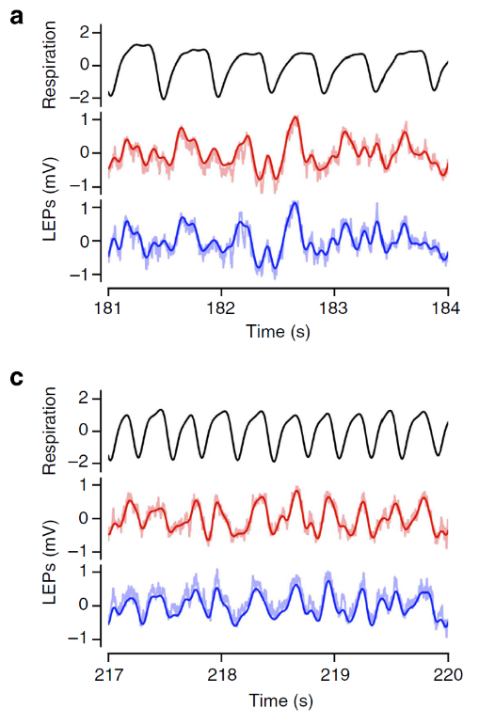
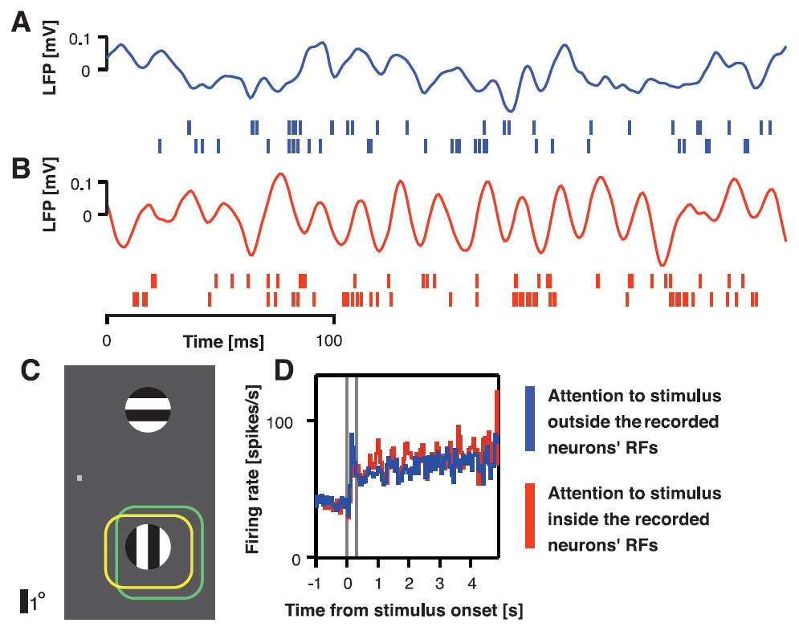
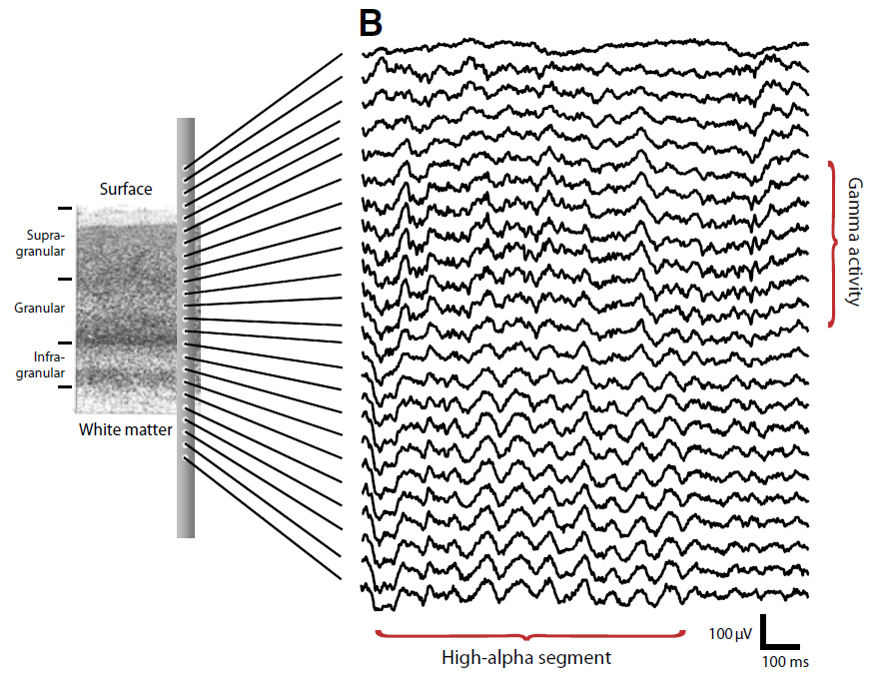
Introduction | oscillations in LFP
Ubiquitous oscillations in LFP
in both response and ongoing activity
in a wide range of frequency
Mouse barrel cortex
Macaque V4
Macaque V1
Fries et al. (2001). Science 291:1560–3
Spaak et al. (2012) Curr. Biol. 2:2313–8
Ito et al. (2014) Nat. Commun. 5:3572

Slide 10
Outline
Introduction
What is LFP? | LFP origin | oscillations in LFP
Spectral Analysis
Fourier transform | power spectrum | coherency
Phase Locking Analysis
Hilbert transform | wavelet transform | phase locking value
Spike-LFP Relation
spike triggered average | spike field coherence | period histogram | vector strength

Slide 11
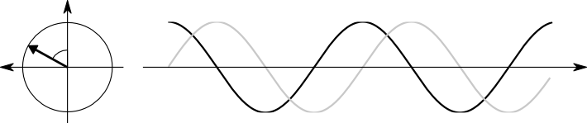
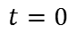
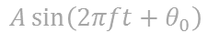
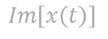
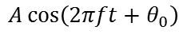
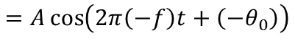
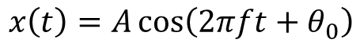
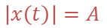
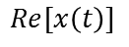
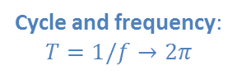
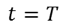

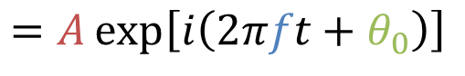

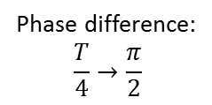
Spectral Analysis | representation of oscillation
Sinusoid:
$$x\left(t\right)=A\cos\left(2πft+θ_{0}\right)$$
$$=A\cos\left(2π\left(−f\right)t+\left(−θ_{0}\right)\right)$$
$$x\left(t\right)=A\cos\left(2πft+θ_{0}\right)+i\sin\left(2πft+θ_{0}\right)$$
$$=A\exp\left[i\left(2πft+θ_{0}\right)\right]$$
Phase difference: $$\frac{T}{4}→\frac{π}{2}$$
$$Re[x\left(t\right)]$$
Cycle and frequency: $$T=1/f→2π$$
$$\left|x\left(t\right)\right|=A$$
Phase offset:
$$θ_{0}$$
Amplitude:$A$
$$Im[x\left(t\right)]$$
$$t=0$$
$$t=T$$
Time
$$A\cos\left(2πft+θ_{0}\right)$$
$$A\sin\left(2πft+θ_{0}\right)$$

Slide 12
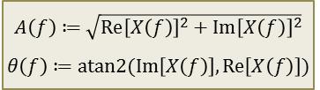
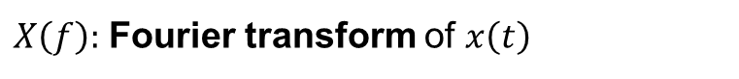
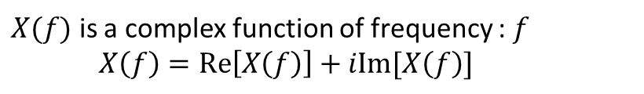
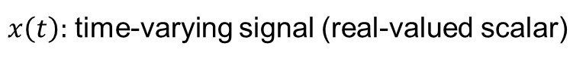
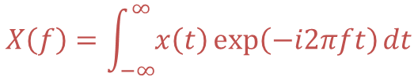
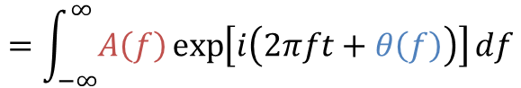
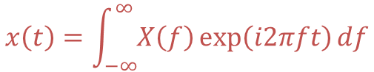
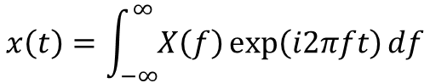
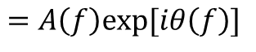
Spectral Analysis | Fourier transform
Decomposition into sinusoids
$x\left(t\right):$ time-varying signal (real-valued scalar)
$X\left(f\right):$ Fourier transform of $x\left(t\right)$
$$X\left(f\right)=\int_{−∞}^{∞}{x\left(t\right)\exp\left(−i2πft\right)dt}$$
$$x\left(t\right)=\int_{−∞}^{∞}{X\left(f\right)\exp\left(i2πft\right)df}$$
$X(f)$ is a complex function of frequency : $f$ $X\left(f\right)=Re\left[X\left(f\right)\right]+iIm[X\left(f\right)]$
$$A\left(f\right)≔\sqrt{Re{\left[X\left(f\right)\right]}^{2}+Im{\left[X\left(f\right)\right]}^{2}}$$
$$θ\left(f\right)≔atan2(Im\left[X\left(f\right)\right], Re\left[X\left(f\right)\right])$$
$$=A\left(f\right)exp⁡[iθ\left(f\right)]$$
Amplitude
Phase
$$x\left(t\right)=\int_{−∞}^{∞}{X\left(f\right)\exp\left(i2πft\right)df}$$
(Inverse Fourier transform)
$$=\int_{−∞}^{∞}{A\left(f\right)\exp\left[i\left(2πft+θ\left(f\right)\right)\right]df}$$
f-Hz sinusoid of amplitude $A(f)$ and phase-offset $θ(f)$

Slide 13
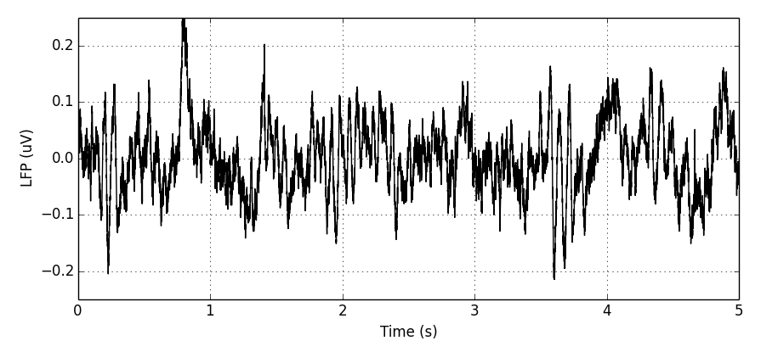
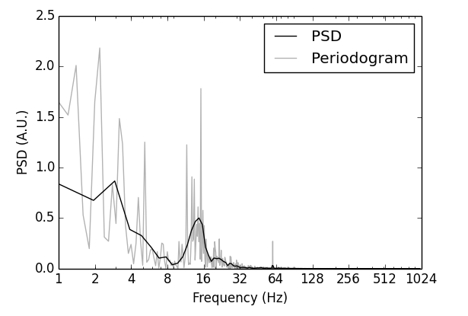
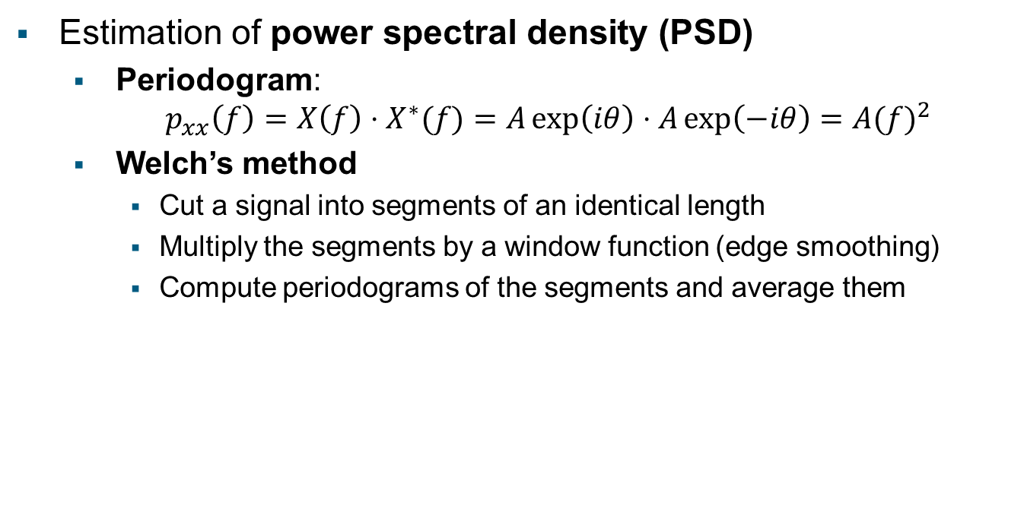
Spectral Analysis | power spectrum
Estimation of power spectral density (PSD)
Periodogram: $p_{xx}\left(f\right)=X\left(f\right)⋅X^{∗}(f)=A\exp\left(iθ\right)⋅A\exp\left(−iθ\right)={A(f)}^{2}$
Welch’s method
Cut a signal into segments of an identical length
Multiply the segments by a window function (edge smoothing)
Compute periodograms of the segments and average them

Slide 14
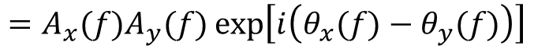
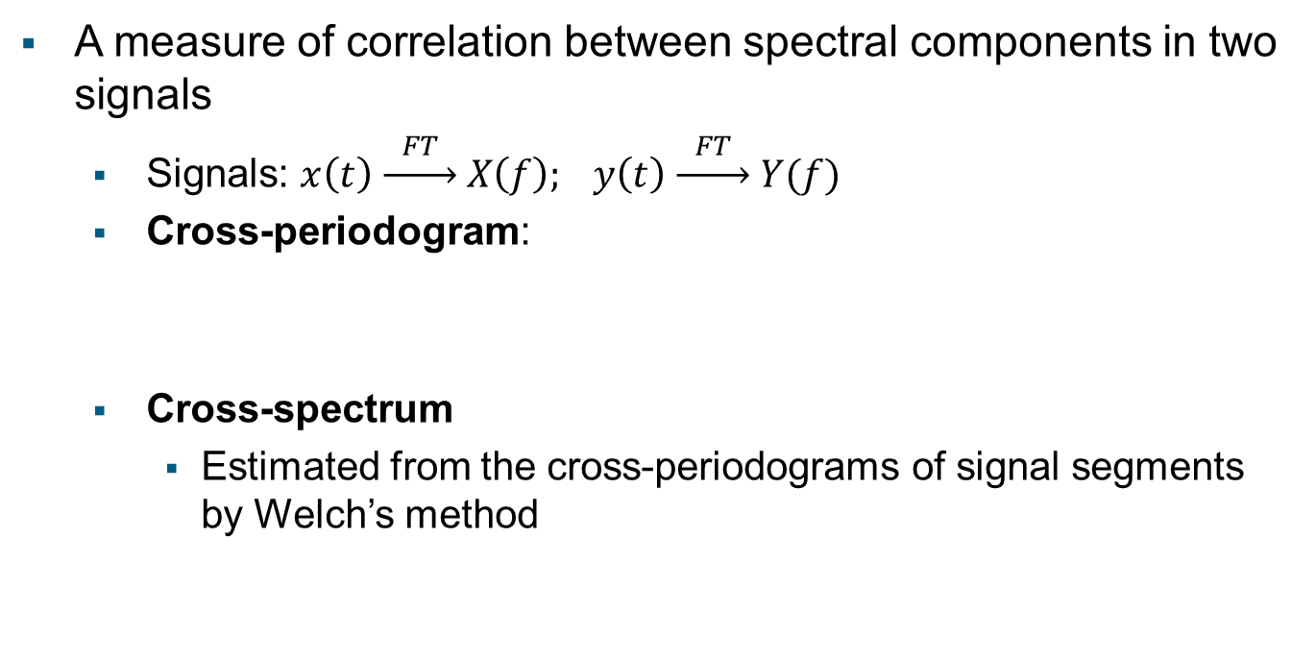
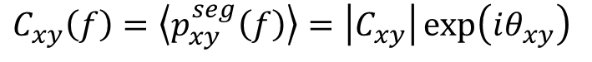
Spectral Analysis | cross-spectrum
A measure of correlation between spectral components in two signals
Signals: $x\left(t\right) \underset{→}{ FT } X\left(f\right); y\left(t\right) \underset{→}{ FT } Y(f)$
Cross-periodogram:
Cross-spectrum
Estimated from the cross-periodograms of signal segments by Welch’s method
$$p_{xy}\left(f\right)=X\left(f\right)⋅Y^{∗}\left(f\right)=A_{x}\exp\left(iθ_{x}\right)⋅A_{y}\exp\left(−iθ_{y}\right)$$
$$=A_{x}(f)A_{y}(f)\exp\left[i\left(θ_{x}(f)−θ_{y}(f)\right)\right]$$
Phase difference
Amplitude cross-spectrum
$$C_{xy}\left(f\right)={{\left\langle p_{xy}^{seg}\left(f\right)\right\rangle =\left|C_{xy}\right|\exp\left(iθ_{xy}\right)}_{ }}_{ }$$
Phase cross-spectrum (average phase difference)
$\left\langle ⋅⋅⋅\right\rangle$: average over segments by Welch’s method

Slide 15
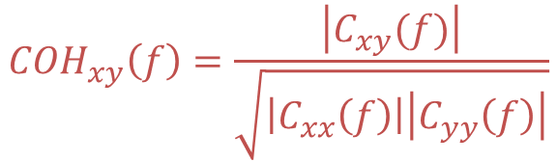
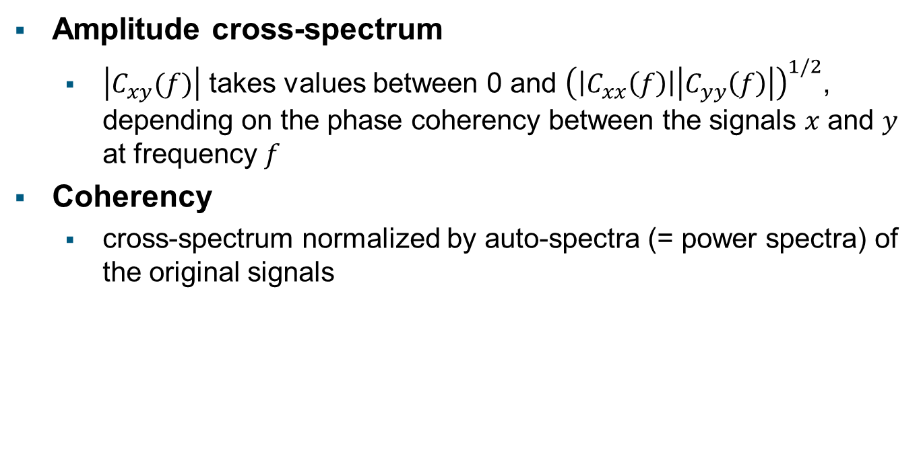
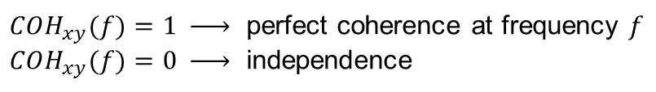
Spectral Analysis | coherency
Amplitude cross-spectrum
$\left|C_{xy}(f)\right|$ takes values between 0 and ${\left(\left|C_{xx}\left(f\right)\right|\left|C_{yy}\left(f\right)\right|\right)}^{1/2}$, depending on the phase coherency between the signals $x$ and $y$ at frequency $f$
Coherency
cross-spectrum normalized by auto-spectra (= power spectra) of the original signals
$${COH}_{xy}\left(f\right)=\frac{\left|C_{xy}(f)\right|}{\sqrt{\left|C_{xx}\left(f\right)\right|\left|C_{yy}\left(f\right)\right|}}$$
$COH_{xy}(f)=1 \underset{→}{ }$ perfect coherence at frequency $f$
$COH_{xy}(f)=0 \underset{→}{ }$ independence

Slide 16
Outline
Introduction
What is LFP? | LFP origin | oscillations in LFP
Spectral Analysis
Fourier transform | power spectrum | coherency
Phase Locking Analysis
Hilbert transform | wavelet transform | phase locking value
Spike-LFP Relation
spike triggered average | spike field coherence | period histogram | vector strength

Slide 17
Phase Locking Analysis | motivation
Spectral analysis yields measures in the frequency domain
No direct insights into signals’ behavior in the time domain
Assumption: signals are stationary in time
In reality, neuronal signals are highly nonstationary
Stimuli are typically not constantly presented but only at specific times (“trials”)
Even without external stimuli, spontaneous activities of neuronal systems are not stationary, but highly irregular
Need for time-resolved spectral analysis
In concrete, methods to estimate instantaneous amplitude and phase of oscillatory signals → Hilbert transform, wavelet transform

Slide 18
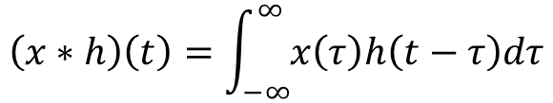
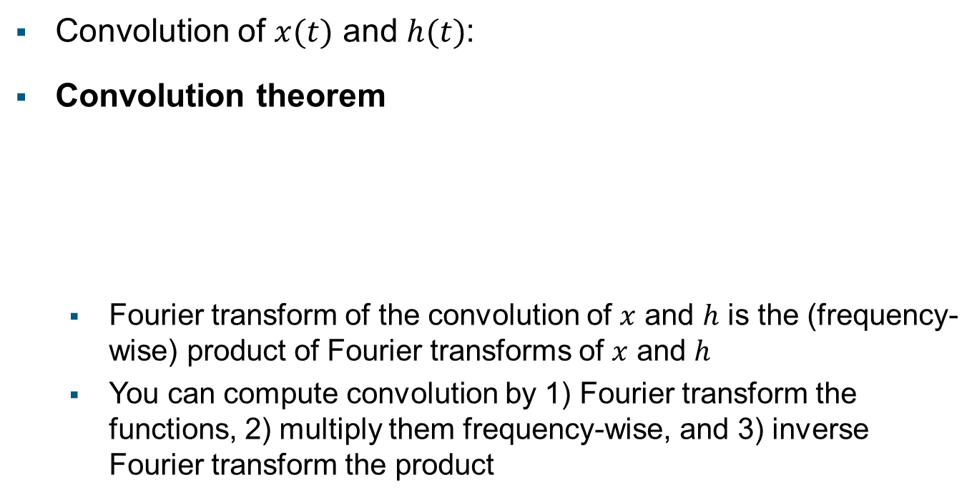
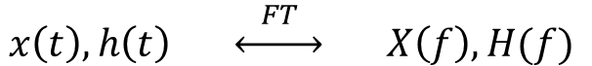
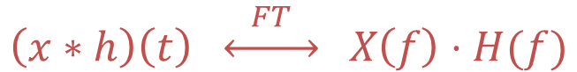
Phase Locking Analysis | convolution theorem
$$\left(x∗h\right)\left(t\right)=\int_{−∞}^{∞}{x\left(τ\right)h\left(t−τ\right)dτ}$$
Convolution of $x(t)$ and $h(t)$:
Convolution theorem
Fourier transform of the convolution of $x$ and $h$ is the (frequency-wise) product of Fourier transforms of $x$ and $h$
You can compute convolution by 1) Fourier transform the functions, 2) multiply them frequency-wise, and 3) inverse Fourier transform the product
$$x\left(t\right), h\left(t\right) \underset{↔}{ FT } X\left(f\right), H(f)$$
convolution
frequency-wise multiplication
$$\left(x∗h\right)\left(t\right) \underset{↔}{ FT } X\left(f\right)⋅H(f)$$

Slide 19
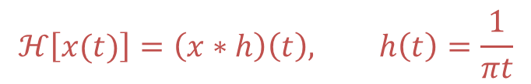
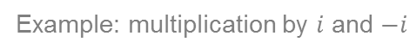
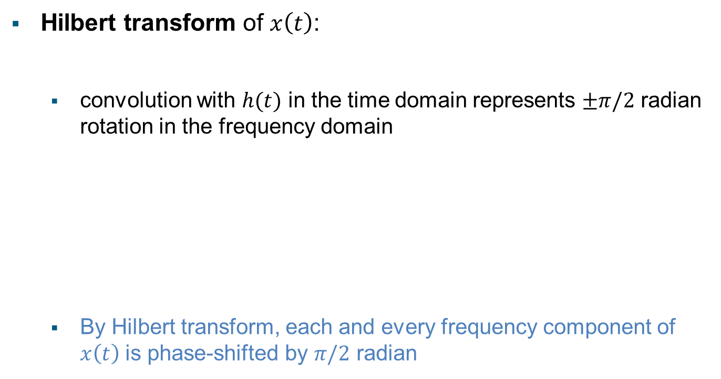
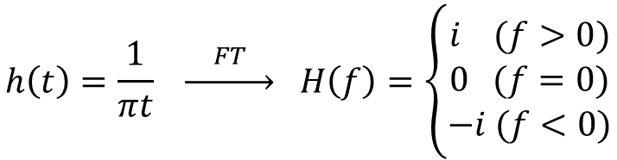
Phase Locking Analysis | Hilbert transform
Hilbert transform of $x\left(t\right)$:
convolution with $h(t)$ in the time domain represents $±π/2$ radian rotation in the frequency domain
By Hilbert transform, each and every frequency component of $x\left(t\right)$ is phase-shifted by $π/2$ radian
$$ℋ\left[x(t)\right]=\left(x∗h\right)\left(t\right), h\left(t\right)=\frac{1}{πt}$$
$$h\left(t\right)=\frac{1}{πt} \underset{→}{ FT } H\left(f\right)=\left\{\begin{matrix}i (f>0) \\ 0 (f=0) \\ −i (f<0)\end{matrix}\right.$$
Example: multiplication by $i$ and $−i$
$$\left(\cos{θ+i\sin{θ}}\right)⋅i=−\sin{θ}+i\cos{θ}=\cos\left(θ+π/2\right)+i\sin\left(θ+π/2\right)$$
$$\left(\cos{θ+i\sin{θ}}\right)⋅\left(−i\right)=\sin{θ}−i\cos{θ}=\cos\left(θ−π/2\right)+i\sin\left(θ−π/2\right)$$

Slide 20
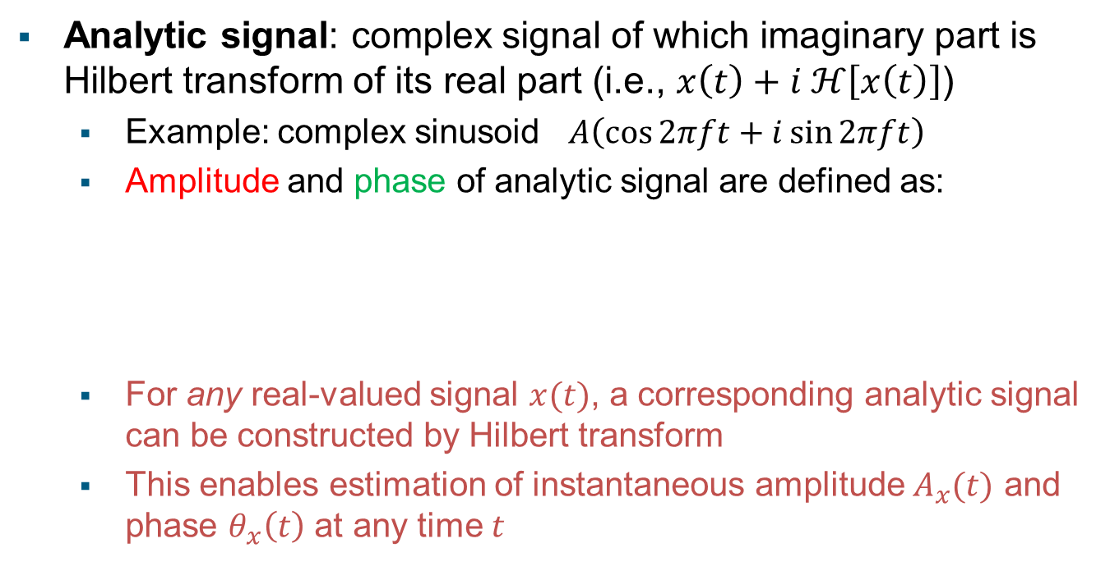
Phase Locking Analysis | analytic signal
Analytic signal: complex signal of which imaginary part is Hilbert transform of its real part (i.e., $x\left(t\right)+i ℋ\left[x\left(t\right)\right]$)
Example: complex sinusoid $A\left(\cos{2πft}+i\sin{2πft}\right)$
Amplitude and phase of analytic signal are defined as:
For any real-valued signal $x(t)$, a corresponding analytic signal can be constructed by Hilbert transform
This enables estimation of instantaneous amplitude $A_{x}(t)$ and phase $θ_{x}\left(t\right)$ at any time $t$
$$\hat{x}\left(t\right)=x\left(t\right)+iℋ\left[x\left(t\right)\right]=A_{x}\left(t\right)\exp\left[iθ_{x}\left(t\right)\right]$$
$$A_{x}\left(t\right)=\sqrt{x{\left(t\right)}^{2}+ℋ{\left[x\left(t\right)\right]}^{2}} θ_{x}\left(t\right)=atan2\left[ℋ\left[x\left(t\right)\right], x\left(t\right)\right]$$

Slide 21
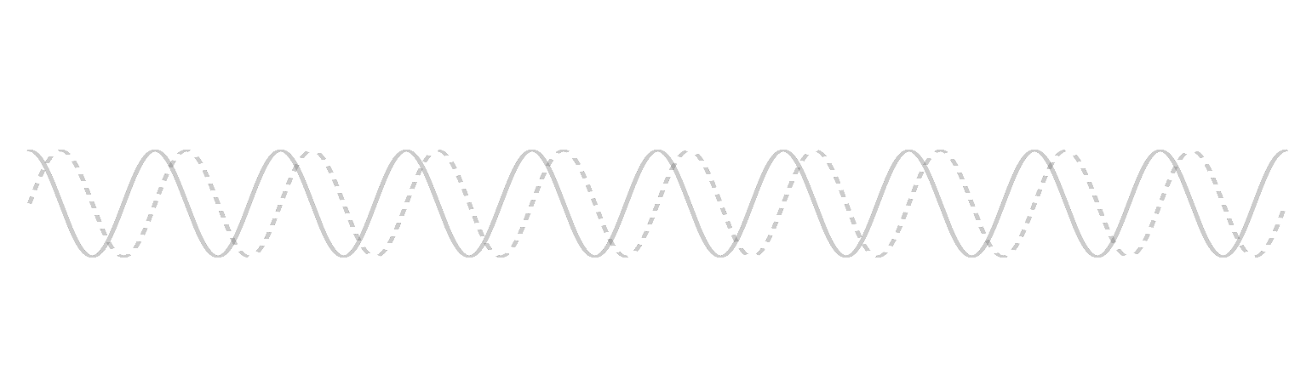





Phase Locking Analysis | wavelet transform
Time- and frequency-resolved decomposition
$x\left(t\right):$ time-varying signal (real-valued scalar)
$W_{x}\left(t,f\right):$ wavelet transform of the signal
$$W_{x}\left(τ,f\right)≔\int_{−∞}^{∞}{x\left(t\right)⋅Ψ_{τ,f}^{∗}\left(t\right)dt}$$
$$Ψ_{τ,f}\left(t\right)≔\sqrt{f}\exp\left(i2πf\left(t−τ\right)\right)\exp\left(−\frac{{\left(t−τ\right)}^{2}}{2σ^{2}}\right)$$
Le van Quyen et al. (2001) J. Neurosci. Meth. 111:83-98
Morlet wavelet
f-Hz sinusoid
Gaussian of width $σ$ centered at $τ$
$$σ=0.083$$
(5 cycles in $±3σ$)

Slide 22












Phase Locking Analysis | wavelet transform
How wavelet transform works
$${Re[W}_{x}(τ,t)]$$
$${Re[W}_{x}(τ,t)]$$
$${Re[W}_{x}(τ,t)]$$
$${Re[W}_{x}(τ,t)]$$
$$x(t)$$
$$W_{x}\left(τ,f\right)≔\int_{−∞}^{∞}{x\left(t\right)⋅Ψ_{τ,f}^{∗}\left(t\right)dt}$$
$$W_{x}(τ,t)$$

Slide 23





Phase Locking Analysis | phase estimation
Estimation with wavelet transform
LFP (uV)
$$f=14.0,σ=0.083$$
WT (A.U.)
$$x\left(t\right) \underset{→}{ WT\left(f,σ\right) }{ W}_{x}\left(t,f\right)=A_{x}\exp{(iθ_{x})}$$
$$A_{x}\left(t,f\right)≔\sqrt{Re{\left[W_{x}\left(t,f\right)\right]}^{2}+Im{\left[W_{x}\left(t,f\right)\right]}^{2}}$$
$$θ_{x}\left(t,f\right)≔atan2(Im\left[W_{x}\left(t,f\right)\right], Re\left[W_{x}\left(t,f\right)\right])$$
Amp.
Phase

Slide 24



Phase Locking Analysis | phase locking value
Instantaneous phase difference as a time-resolved measure of correlation between oscillatory signals
Constant phase difference over a period of time → phase locking
Phase locking value (PLV) for $x=A_{x}\exp{iθ_{x}}$ and $y=A_{y}\exp{iθ_{y}}$
$$PLV_{xy}=\frac{1}{N}\left|\sum_{j=1}^{N}{\exp\left\{i\left[θ_{x}^{ }(t_{j})−θ_{y}^{ }(t_{j})\right]\right\}}\right|$$
Varela et al. (2001) Nat. Rev. Neurosci. 2:229–39

Slide 25

Phase Locking Analysis | an example application
Rodriguez et al. (1999), EEG recording from human subjects
Viewing of “Face” and “Nonsense” images
Phase locking analysis over a range of frequencies (20 – 60 Hz)
High PLVs at ~40 Hz only in Face viewing condition
Varela et al. (2001) Nat. Rev. Neurosci. 2:229–39

Slide 26
Outline
Introduction
What is LFP? | LFP origin | oscillations in LFP
Spectral Analysis
Fourier transform | power spectrum | coherency
Phase Locking Analysis
Hilbert transform | wavelet transform | phase locking value
Spike-LFP Relation
spike triggered average | spike field coherence | period histogram | vector strength

Slide 27

Spike-LFP Relation | spike-LFP parallel recording
Montemurro et al. (2008), recording from V1 of anesthetized macaques
Repeatedly stimulated with a natural movie
Reliable oscillatory LFP responses across trials
How are spike timings related to the phase of LFP oscillations? How to quantify the relation?
Montemurro et al. (2008) Curr. Biol. 18:375–80

Slide 28

Spike-LFP Relation | spike triggered average
Average of LFP segments with spike times as triggers
If spikes prefer a specific phase of the LFP oscillation, its oscillatory waveform would remain in the average, while random fluctuations would be averaged out
...but, how can one tell if an obtained STA reflects phase locking or remaining fluctuations? → need for significance test

Slide 29

Spike-LFP Relation | significance test
Spike time randomization for significance test
Generate a surrogate spike data by randomly shuffling spike times
Compute STA using the surrogate spike data and the original LFP data
Repeat 1 and 2 many times (typically > 1,000)
Compute the distribution of surrogate STAs, and test the significance of the original STA against it

Slide 30

Spike-LFP Relation | spike-field coherence
STA can give a spurious result when the LFP has large power in other frequencies than the one that spikes are related to
In such cases, STA needs to be “normalized” by the power in each frequency → Spike-field coherence (SFC)
Fries et al. (2002) J. Neurosci 22:3739-54

Slide 31

Spike-LFP Relation | spike-field coherence
SFC is...
defined as the power spectrum of STA divided by the power spectrum of the LFP
a measure in the frequency domain
a normalized measure taking a value between 0 and 1 for each frequency (0: independence; 1: perfect coherence)
actually coherency between spike train and LFP (with spike train represented as sum of delta peaks)
STA
PSD of STA
PSD of LFP
SFC
Fries et al. (2002) J. Neurosci 22:3739-54

Slide 32


Spike-LFP Relation | an example application
Chalk et al. (2010), recording from V1 and V4 of awake behaving macaques
SFC reflects attentional state of the animal
Chalk et al. (2010) Neuron 66:114-25

Slide 33
Spike-LFP Relation | phase locking analysis
Phase extraction enables characterization of spike-LFP relation with a fine temporal resolution
What phase do spikes prefer? How are spike times distributed across phases within a cycle? → period histogram
Montemurro et al. (2008) Curr. Biol. 18:375–80

Slide 34


Spike-LFP Relation | period histogram
Simultaneously recorded LFP and spikes
LFP: $x\left(t\right)=A_{x}\left(t\right)\exp\left[iθ_{x}\left(t\right)\right]$
spike times: $S=\left\{τ_{1}, τ_{2}, …, τ_{N}\right\}$
Phases at spike times: $φ_{i}=θ_{x}\left(τ_{i}\right) \left(1≤i≤N\right)$
Histogram of $φ_{i}$ is called period histogram
Denker et al. (2011) Cereb. Cortex 21:2681-95

Slide 35



Spike-LFP Relation | vector strength
Vector strength (or mean vector length):
c.f. (LFP-to-LFP) phase locking value
Quantifies the degree of spike-to-LFP phase locking
$$R=\frac{1}{N}\left|\sum_{j=1}^{N}{\exp\left\{i\left[θ_{x}\left(τ_{j}\right)\right]\right\}}\right|$$
$$PLV_{xy}=\frac{1}{N}\left|\sum_{j=1}^{N}{\exp\left\{i\left[θ_{x}^{ }(t_{j})−θ_{y}^{ }(t_{j})\right]\right\}}\right|$$
$R=1 \underset{→}{ }$ perfect phase locking
$R=0 \underset{→}{ }$ independence

Slide 36




Spike-LFP Relation | an example application
Denker et al. (2011), recording from M1 of awake behaving macaques (note: circular std. dev. $σ=\sqrt{−2\log{R}}$)
Denker et al. (2011) Cereb. Cortex 21:2681-95

Slide 37
Outline
Introduction
What is LFP? | LFP origin | oscillations in LFP
Spectral Analysis
Fourier transform | power spectrum | coherency
Phase Locking Analysis
Hilbert transform | wavelet transform | phase locking value
Spike-LFP Relation
spike triggered average | spike field coherence | period histogram | vector strength

Slide 38
Advanced Topics
Analysis of oscillatory response activities
Phase-amplitude coupling
Time-resolved spike-to-LFP phase locking analysis

Slide 39

Analysis of Response | response types
Additive response
Phase resetting
: amplitude increase
: no amplitude change, but phase reset
Trials
Trigger event
Event triggered average
Mazaheri and Jensen (2010) Front. Hum. Neurosci. 4:177

Slide 40

Analysis of Response | response types
Evoked response: fixed latency → phase coherence across trials
Induced response: jitter in latency → no phase coherence across trials
Tallon-Baudry and Bertrand (1999) Trend Cogn Sci 3:151-162

Slide 41
Analysis of Response | response types
Response type |  | Amplitude Increase | Phase coherence
Phase resetting |  | ✗ | ✓
Additive | Evoked | ✓ | ✓
 | Induced | ✓ | ✗

Slide 42


Analysis of Response | coherence measure
Inter-trial phase coherence (IPC)
$$IPC≔\frac{1}{N}\left|\sum_{j=1}^{N}{\exp\left(iφ_{j}\right)}\right| (N:\# trials)$$

Slide 43


Analysis of Response | coherence measure
Inter-trial phase coherence (IPC)
$$IPC≔\frac{1}{N}\left|\sum_{j=1}^{N}{\exp\left(iφ_{j}\right)}\right| (N:\# trials)$$

Slide 44



Analysis of Response | example
Eye movement related LFP modulation in macaque V1
Induced additive
Event triggered average
Amplitude modulation
Evoked additive
Phase resetting
Induced additive
Inter-saccade phase
coherence
Evoked additive
Phase resetting
Ito et al. (2013) Front. Syst. Neurosci. 7:1
Time from saccade onset (ms)

Slide 45

Phase-amplitude coupling | definition
Phase-amplitude coupling (PAC)
modulation of the amplitude of a fast frequency component coherent with the phase of a slow frequency component
Jensen and Colgin (2007) Trends Cogn. Sci. 11:267-9

Slide 46




Phase-amplitude coupling | PAC measure
Mean vector length (MVL)
Composite signal:
$$X\left(t\right)≔A\left(t\right)\exp\left(iΦ\left(t\right)\right)$$
Mean vector length (MVL)
$$MVL≔\sqrt{{\left\langle Re\left[X\left(t\right)\right]\right\rangle }^{2}+{\left\langle Im\left[X\left(t\right)\right]\right\rangle }^{2}}$$
$$\left\langle ⋅\right\rangle :temporal average$$

Slide 47

Phase-amplitude coupling | example
Mouse barrel cortex LFP oscillations linked to respiration
Ito et al. (2014) Nat. Commun. 5:3572

Slide 48


Phase-amplitude coupling | example
Mean vector length
1
2
4
8
16
32
64
128
256
Frequency for amplitude (Hz)
Ito et al. (2014) Nat. Commun. 5:3572

Slide 49

Phase Locking Analysis | spike-to-LFP locking
Temporal relation between LFP and firing rate

Slide 50

Phase Locking Analysis | spike-to-LFP locking

Slide 51



Phase Locking Analysis | spike-to-LFP locking
Spike-to-LFP phase locking value (PLV)
$$PLV≔\frac{1}{N}\left|\sum_{j=1}^{N}{\exp\left(iφ_{j}\right)}\right| (N:\# spikes)$$

Slide 52


Phase Locking Analysis | example
Time resolved spike-to-LFP phase locking analysis
phase locking calculated separately for first and second spikes after fixation onset
Surprise of PLV
Ito et al. (2011) Cereb. Cortex 21:2482-97

